Slide 1

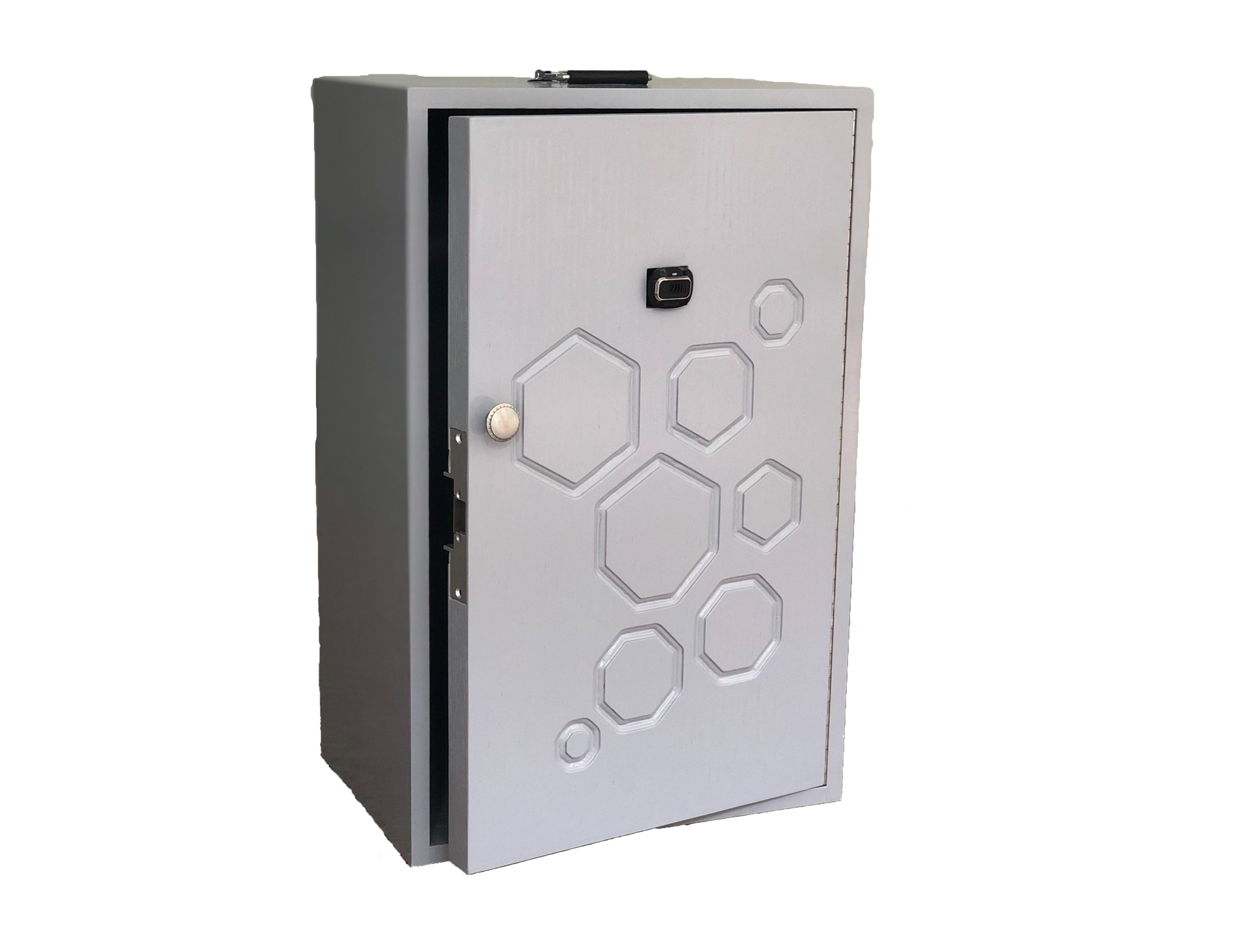
North Easter Regional Institute of Science and Technology
Department of Computer Science and Engineering
Degree Project
Guide: Dr. Monjul Saikia
SAURABHJYOTI DEURI (D/18/CS/103)
DHRUBARK SARMAH (D/18/CS/106)

Slide 2

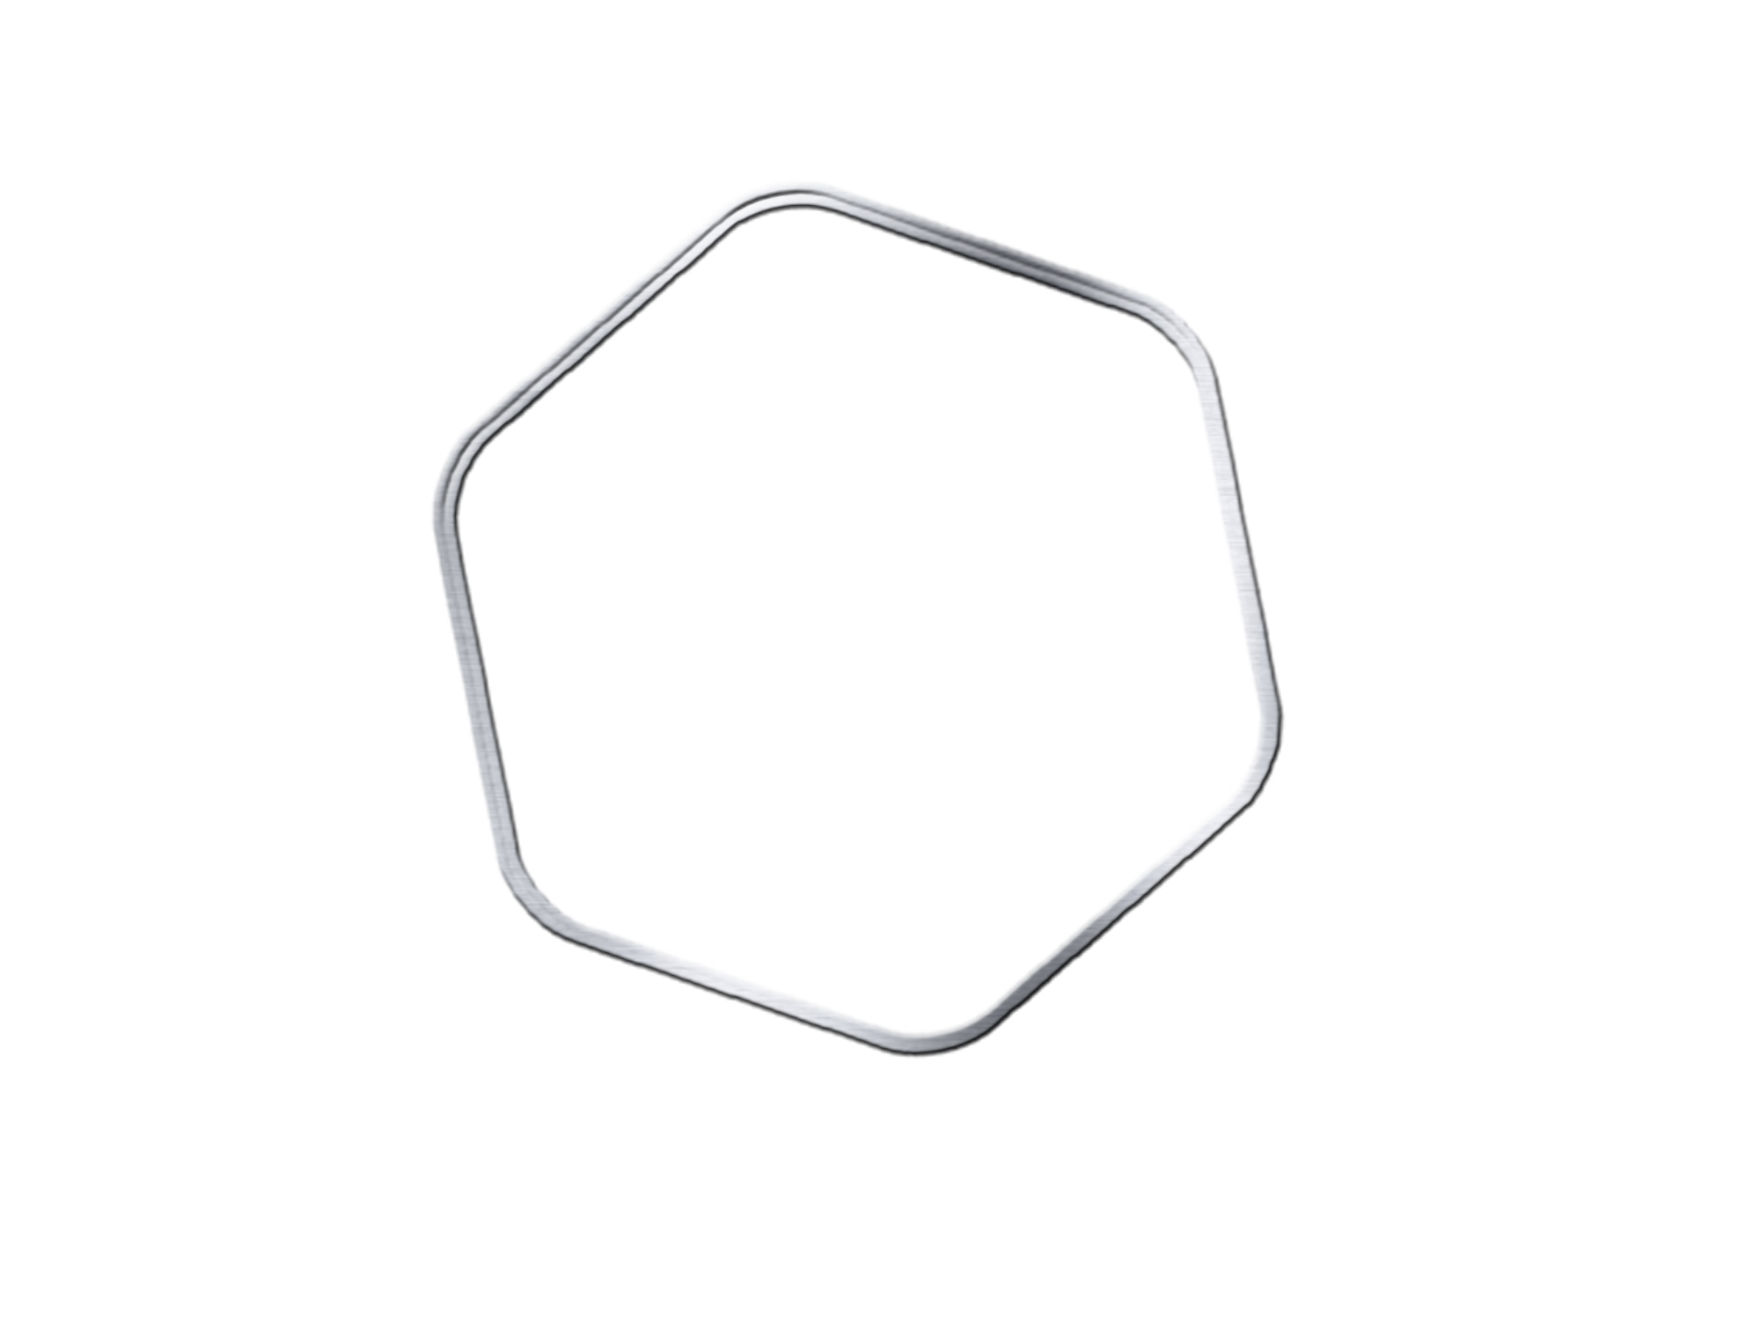



Outline
Introduction
Requirements
Project Components
Methodology
Project Functionality
Constraints
Hardware Design
Difficulties
Conclusion
Applications
Future Work
Summary
Notes:
Lama’s

Slide 3
What is Facial Recognition Door?
An autonomous door, used in security systems that is capable of recognizing and identifying a person from a digital image.
Notes:
Lama’s

Slide 4
Project Objectives
Improving the security system in the houses, buildings and work environment, by making a smart entryway, which anchors the gateway dependent on our character.
Notes:
Amal’s

Slide 5
Requirements of the Project
Scalability | Should be designed to be able to handle many users in the database and doors, which are connected over the same database system.
Flexibility | Should be not restricted to a certain place.
Usability | Should be easy to use by people.
Reliability | User can reliable that the door will verify his identification and open for him. Should be reliable that the other users can’t tamper the door system to be unlocked.
Table 1: Project Requirements
Notes:
Lujain’s

Slide 6
Project Components - Hardware
Solenoid Lock
SD Card
12V DC adapter
Raspberry Pi 4 Model B
PiCam
Relay Module
Jumper Wires
Notes:
Shaikha’s

Slide 7
Project Components - Software
Python
Raspberry Pi OS
OpenCV
Notes:
Shaikha’s & Bashayer: how we chose them

Slide 8
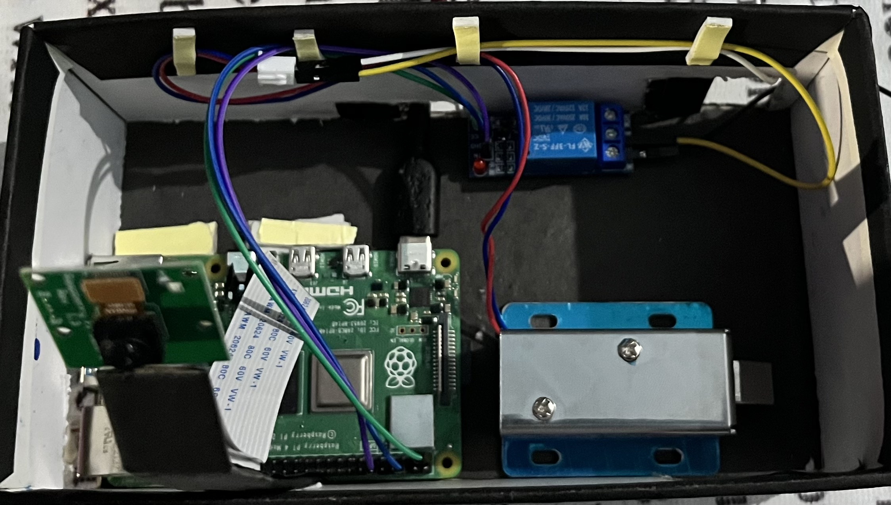
Methodology
This project is handled with a Raspberry Pi 4 model B+ which is an ARM-based single board computer.
operating system Raspberrypi OS
Python
OpenCv
Figure 3: Model
Notes:
Lama’s

Slide 9
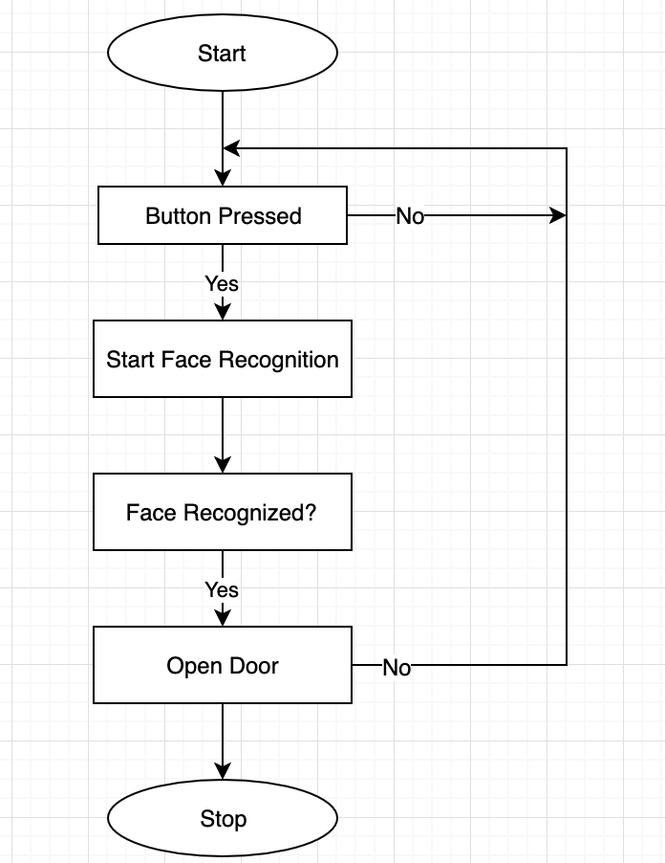
Procedural View of Detection Process
When the person press the button, the implemented code now called. Using the camera, the system capture the image sequence and compare this image with the database. if the image is a match, then in application module get the signal to unlock the door.
Figure 4: Detection Process
Notes:
Amal’s

Slide 10
Project Functionality
Controllability | Adding identities, that must be recognised over the database.
Admin user of the door is able to add multiple pictures of a user in the database.
Accuracy | User can be wearing various things on his face or head, with no effects on the process of recognizing.
Identification | Verifying the users, who can be allowed to open the door at anytime.
Security | Ensuring a security for users.
Table 2: Project Functionality
Notes:
Shaikha’s

Slide 11
Constraints - Design
The hardware implementation of the face recognition door is important because it will be used in many real time applications.
The hardware devices and software applications selected carefully to obtain the high level of quality
The input images that contain the recognized face need a certain pre-processing
In order to obtain the recognition in high level the face recognition door have only two main recognition phases:
feature identification
Feature extraction
Notes:
Lujain’s & Bashayer’s

Slide 12
Hardware Design
Figure 3: Electrical Circuit
Notes:
Amal’s

Slide 13
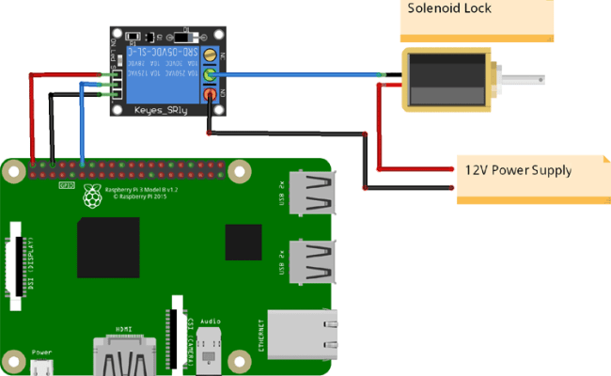
Hardware Schematic-Model
Figure 6: Schematic Model
Notes:
Amal’s

Slide 14
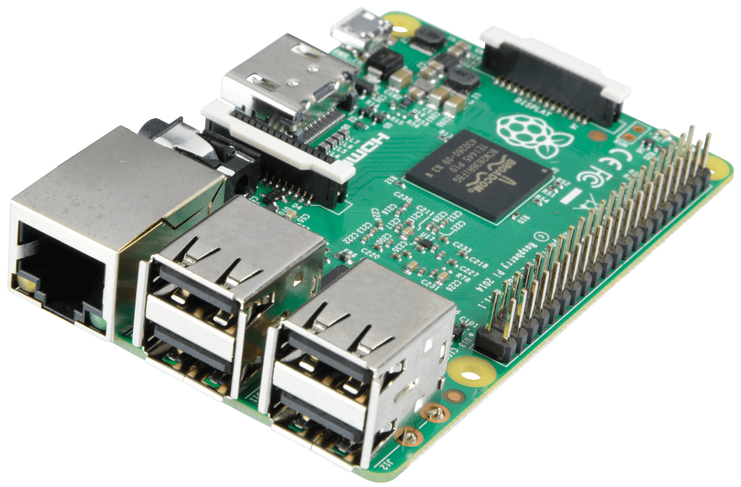
Raspberry Pi 4 Model B
Raspberry Pi 4 Model B has 4GB RAM
A high-performance 64-bit quad-core processor
Hardware video decoding up to 4Kp60
A connection to the dual-band wireless local area network 2.4/5.0 GHz
Bluetooth 5.0 / Gigabit Ethernet / USB 3.0 / PoE features (via a separate HAT PoE add-on module)
Notes:
Amal’s

Slide 15

Difficulties
The team members have faced some challenges during working on the project but there is no project that works perfectly without any challenges and difficulties while working on it.
Challenges and difficulties
SD Card.
Raspberry pi.
Software worked perfectly, then it stopped working.
Camera not being able to detect.
Notes:
Lujain

Slide 16
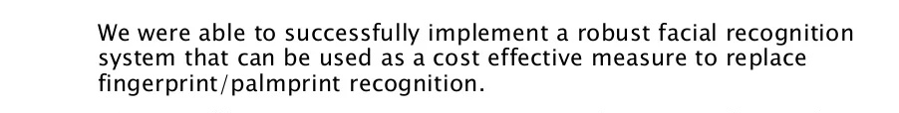
Conclusion
We were able to recognize an object using OpenCv and python on Raspberry pi OS and open and close a physical door(lock). The algorithm is limited by different lighting and camera conditions. Also the algorithm need ample training sets to identify an object with precision.
Notes:
Lujain

Slide 17
Applications
Since the project idea is mainly about security and safety, the sector of use and application was ideally selected for the following areas:
House, prison, mall or Shop, hospital, university, company, library, and lockers.
Notes:
Shaikha’s

Slide 18
Future Work
To transfer this model to be run on cloud, this hugely increasing efficiency and lowering cost.
To utilized for night observation with development of raspberry pi security conventions.
Adding infrared producing system to recognize individual's face on the off chance that they wore mask
Phone application to provide several services
Notes:
Shaikha’s

Slide 19
Summary
This project has essentially highlights: increasing the security and safety method, control and observing the automation to home/work or any selected environment. By applying this project there will be more security and trustiness in the home or any selected place, facial recognition project helps in prevent playing or cheating with the identities, so no one can enter a selected place unless he or she has a permission, this would help in order to have smart and safe life (in security) Finally, we have complete this project efficaciously and gained suitable results.

Slide 20
Thank You

